Slide 1
RAIN Native Expressions from the American Southwest

Slide 2
Rain themes
Representations of clouds, rain, and water
Representations of animals associated with water
Representations or sounds of phenomenon associated with rain such as lightning and thunder
Materials that are associated with water animals such as shell
Materials that are the color of water such as turquoise
Cultural associations: Ancestral People, Hopi, New Mexico Pueblos, Tohono O’odham, Diné, Indé.

Slide 3
Ancestral Pueblo Signs of Rain

Slide 4
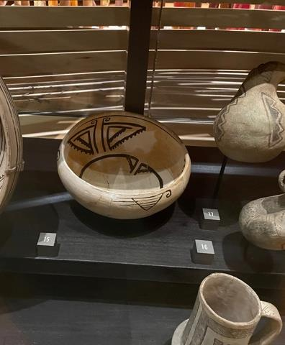
Ancestral Zuni Pinnawa Glaze-on-white bowl, 1350-1450 CE
A specialist in the production of glazeware pottery made this bowl. Stylized butterflies are painted on the interior and birds on the exterior, two creatures that are on historic and contemporary Zuni ceramics. Analysis of the clay and glaze used in this pottery indicates that there were only a few sources for this pottery among the nine protohistoric villages along the Zuni River and its tributaries.

Slide 5
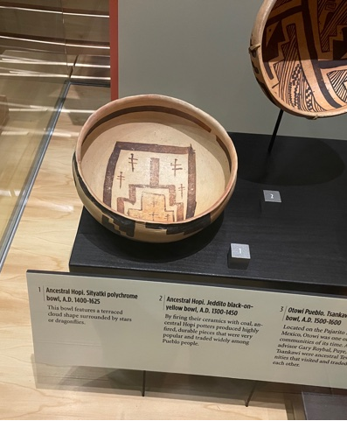
Ancestral Hopi Sikyatki polychrome bowl 1400-1625 CE
This bowl features a terraced cloud shape surrounded by stars or dragonflies.

Slide 6
New Mexico Pueblos Eileen Yatsattie and Cal Seciwa, Zuni advisors Gary Roybal, San Ildefonso advisor Laura Roybal, San Felipe advisor

Slide 7
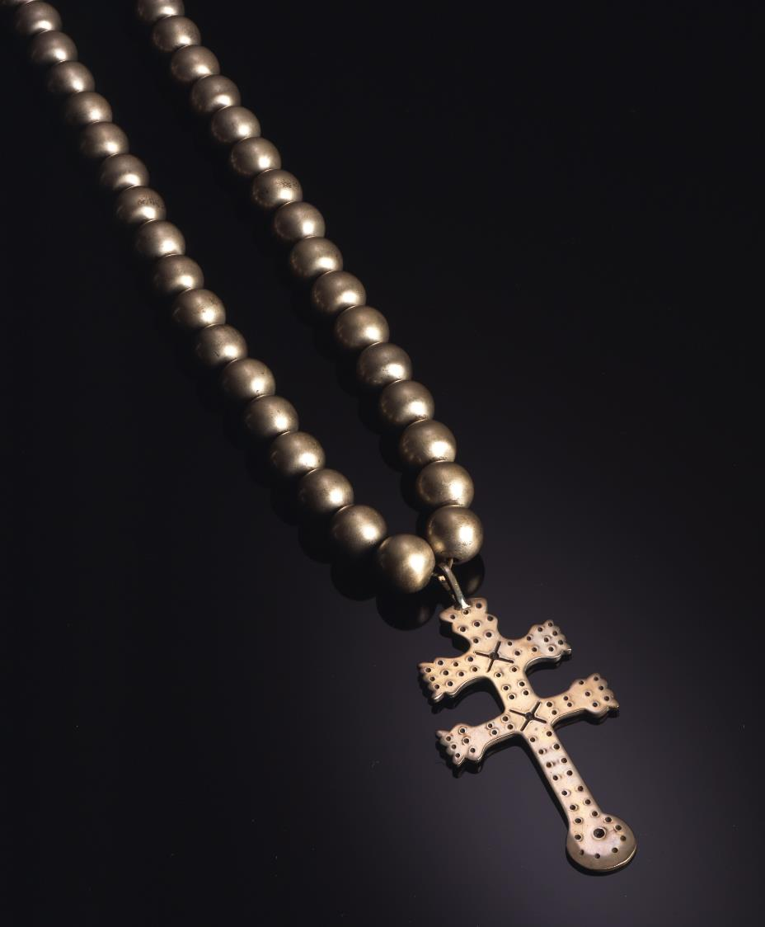
Mike Bird-Romero Okay Owingeh Necklace, 1991
Mike’s wife Allison wrote Heart of the Dragonfly. In the book she makes the connection between the crosses of the Spanish and ancestral designs such as the double barred cross of Lorraine and the dragonfly associated with summer rains.

Slide 8
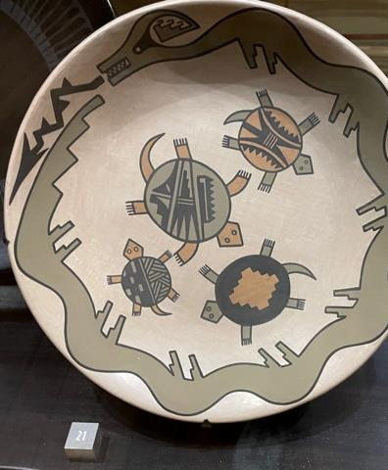
Blue Corn Calabaza San Ildefonso Pueblo Polychrome Plate, 1970-1977
An Avanyu or horned water serpent with a tongue of lightning and turtles are featured on this plate. In the 1970s, Blue Corn created a version of the historic San Ildefonso polychrome style of painting on ceramics.

Slide 9
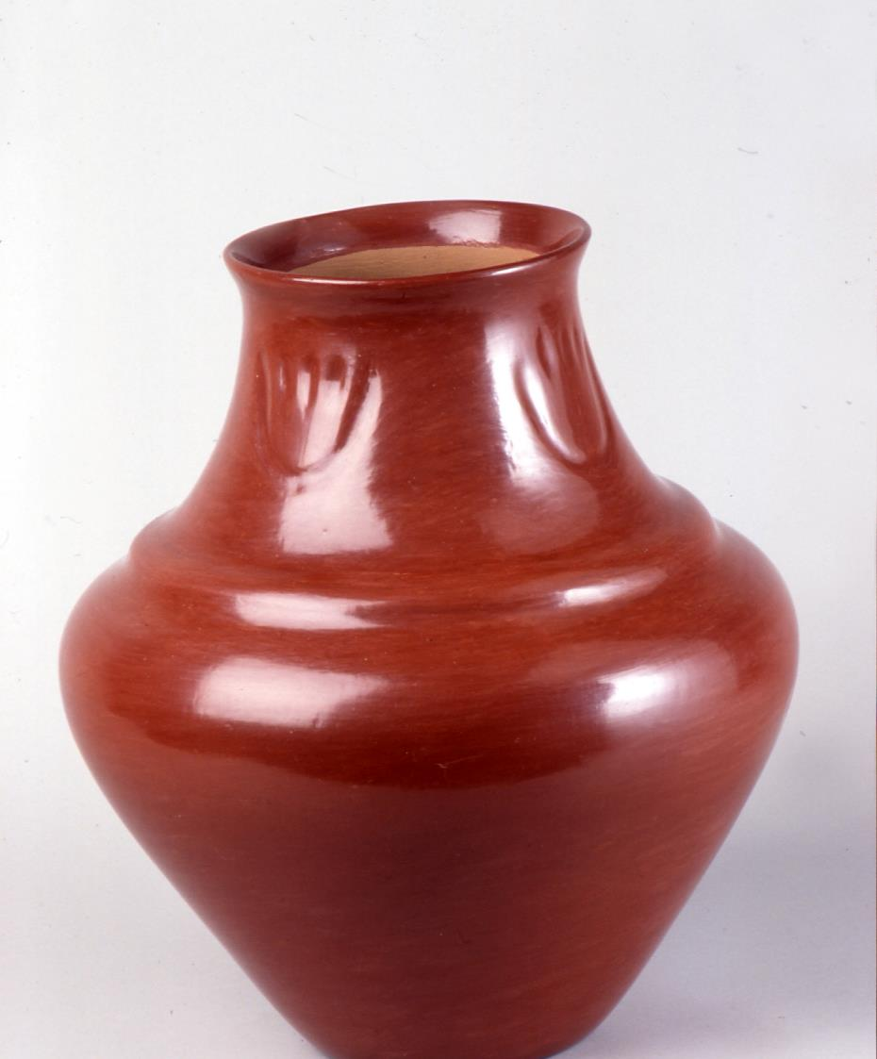
Margaret Tafoya Santa Clara Pueblo Jar with bear paw, c. 1973
The bear paw references the origin story of Santa Clara Pueblo in which a bear leads the people of Santa Clara to water. According to Margaret Tafoya, the raised element below the bear paw is referred to as a rainbow.

Slide 10
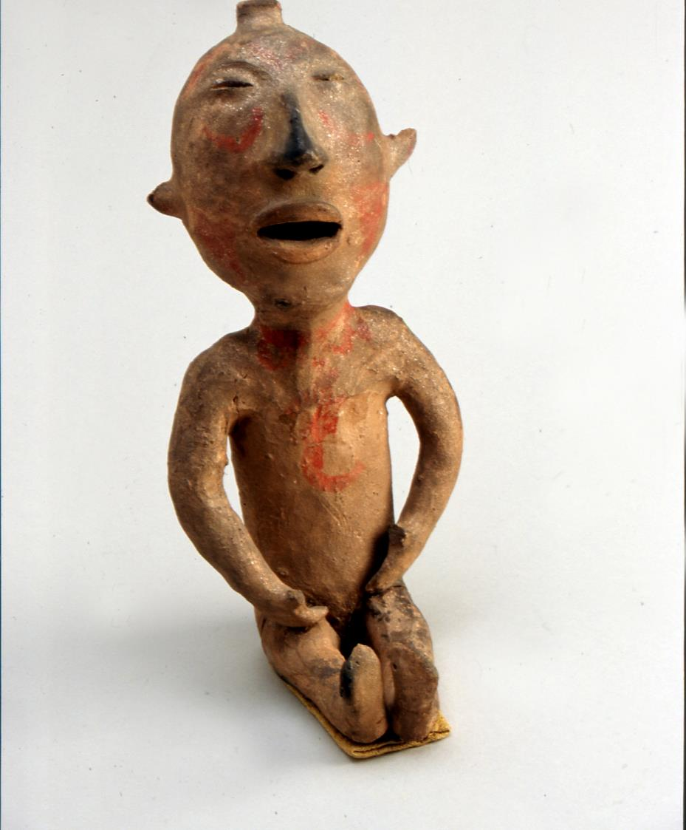
Tesuque Rain God Figurine, c. 1890
This early example of a “rain god” was made before the mass marketing of the figures by Santa Fe merchant Jake Gold between 1900 and 1940. Gold sold them to stores across the country.

Slide 11
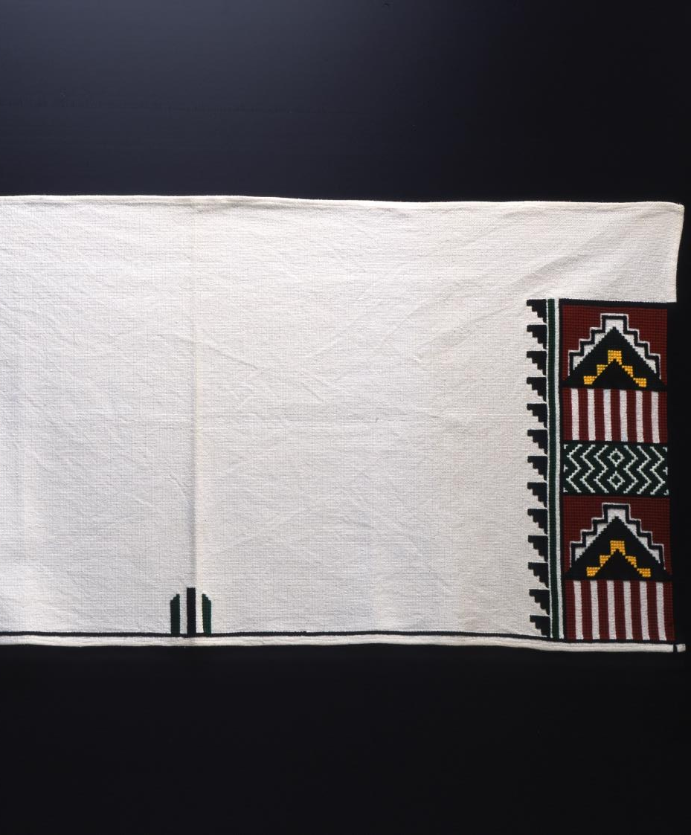
Florence Yepa, Jemez Pueblo Kilt, 2002
Florence Yepa said that this kilt is worn at social and harvest dances. It is a new style done in cross-stitch. It is worn as a kilt by men and over shoulders of women. On the kilt are the stepped clouds, the rain and the lightning. The red represents the sky and the green, the earth.

Slide 12
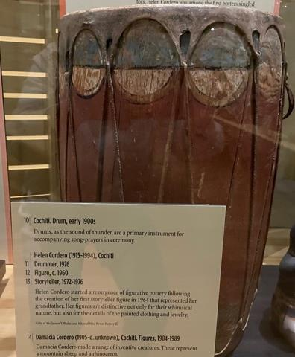
Cochiti Drum, early 1900s
Drums represent the sound of thunder and the arches formed where the drumhead meets the drum’s body have been called a representation of clouds.

Slide 13
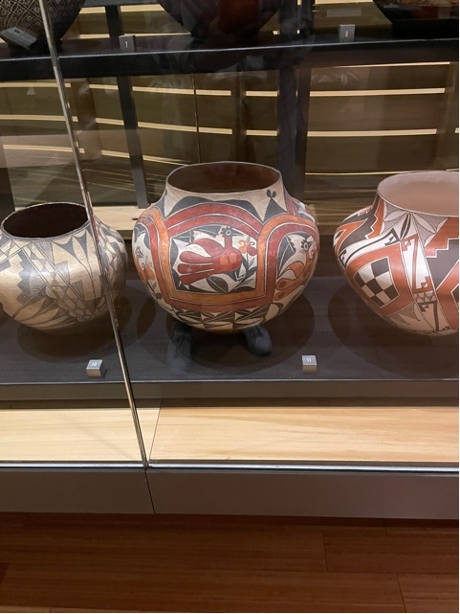
Acoma Jar, 1890-1920
Rainbows, associated with rain that nourishes animals and plants, is a frequent design theme of Pueblo pottery. In the HOME label text, Emma Lewis comments on the sweet taste of water from this type of jar.

Slide 14
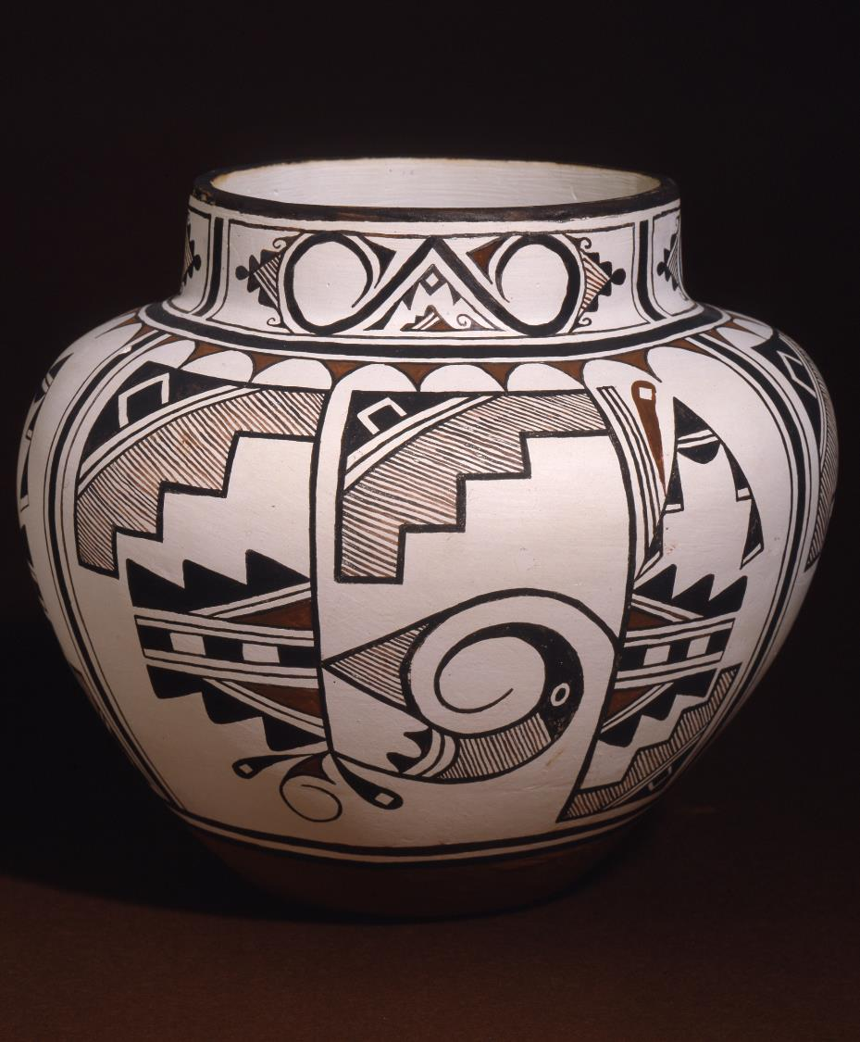
Josephine, Milford and Randy Nahohai, Zuni Jar, 1983
This is a rainbird design, and it shows the movement of the clouds as they are coming in. Without the eye the design is one of swirling clouds.

Slide 15
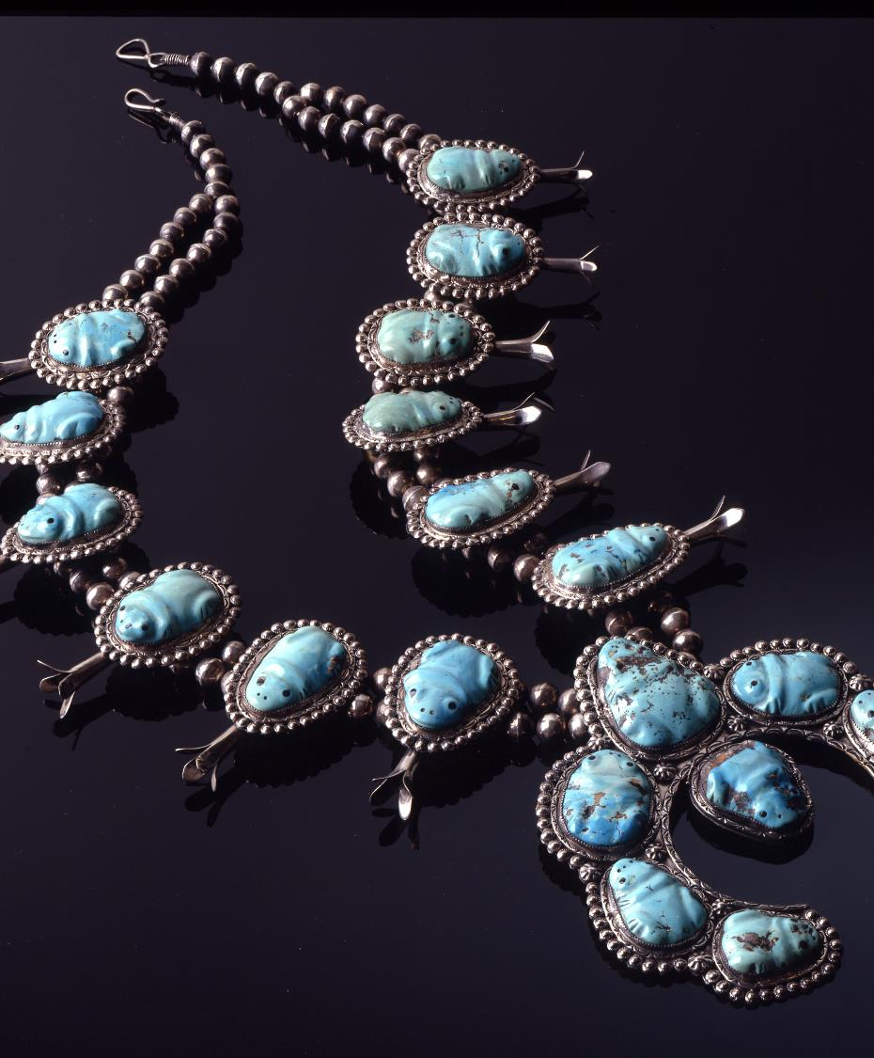
Leekya Deyuse, Zuni Frog necklace, 1939
This is part of a set. Leekya was known by his first name and is known for his fetish carvings. Eileen Yatsattie said, “We believe when rains come, the frogs fall down from the sky with the rain.”

Slide 16
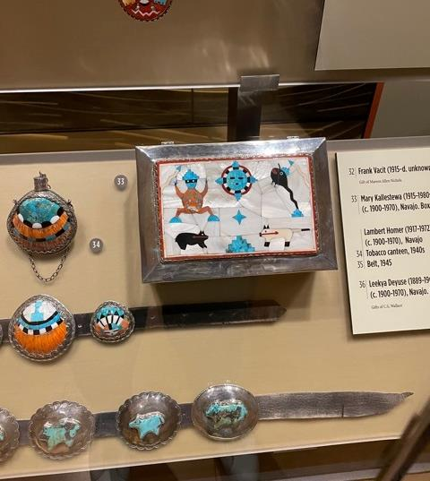
Mary Kalestewa (Zuni) and John Hoxie or Roger Skeet (Diné), Inlay Box, 1948
The water animals, frog and tadpole, are capped by cloud “hats” and surrounded by lightning bolts.

Slide 17
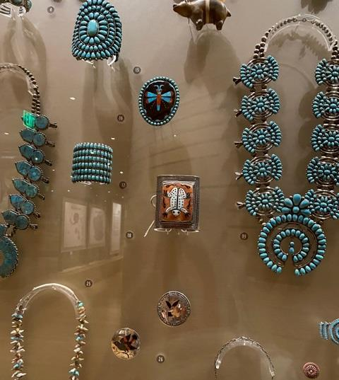
More Zuni water animals—frog and dragonfly.

Slide 18
Hopi Clifford Lomahaftewa, advisor

Slide 19
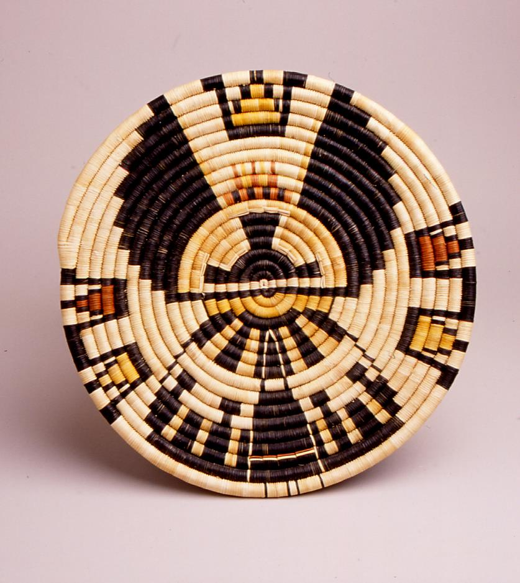
Roberta Namingha, Tewa/Hopi Crow Mother plaque, c. 1969
Namingha surrounded Crow Mother with stylized clouds and lightning.

Slide 20
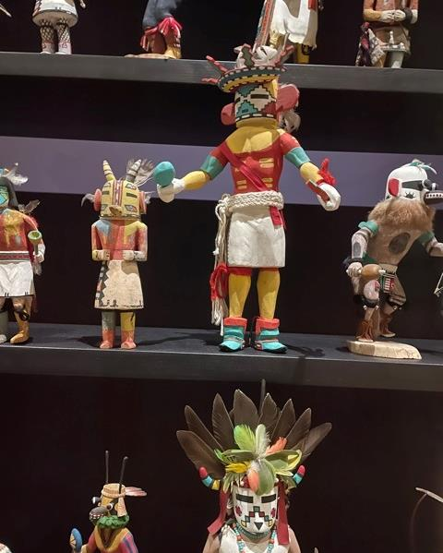
Snow Katsina Doll, 1970s
Snow clouds surround the eyes of this Katsina while a rainbow with lightning bolts surrounds his head. He is also wearing a rain sash. He is responsible for bringing cold and winter moisture to the Hopi mesas.

Slide 21
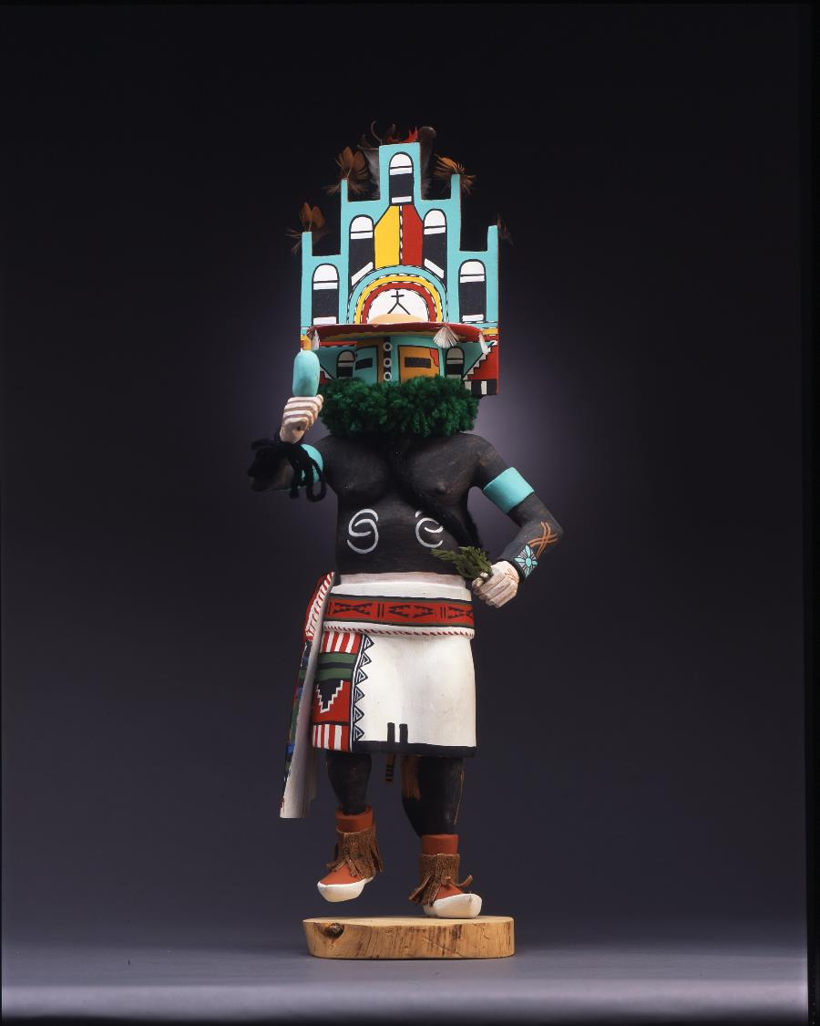
Tino Youvella, Hopi, Hemis Katsina Doll, c. 1983
The kopatsoki is in the shape of a cloud and the small feathers also represent clouds. A rainbow is beneath the clouds.
The kilt has clouds with falling rain. This is one of the dolls that Clifford Lomahaftewa selected for the RAIN exhibit.

Slide 22
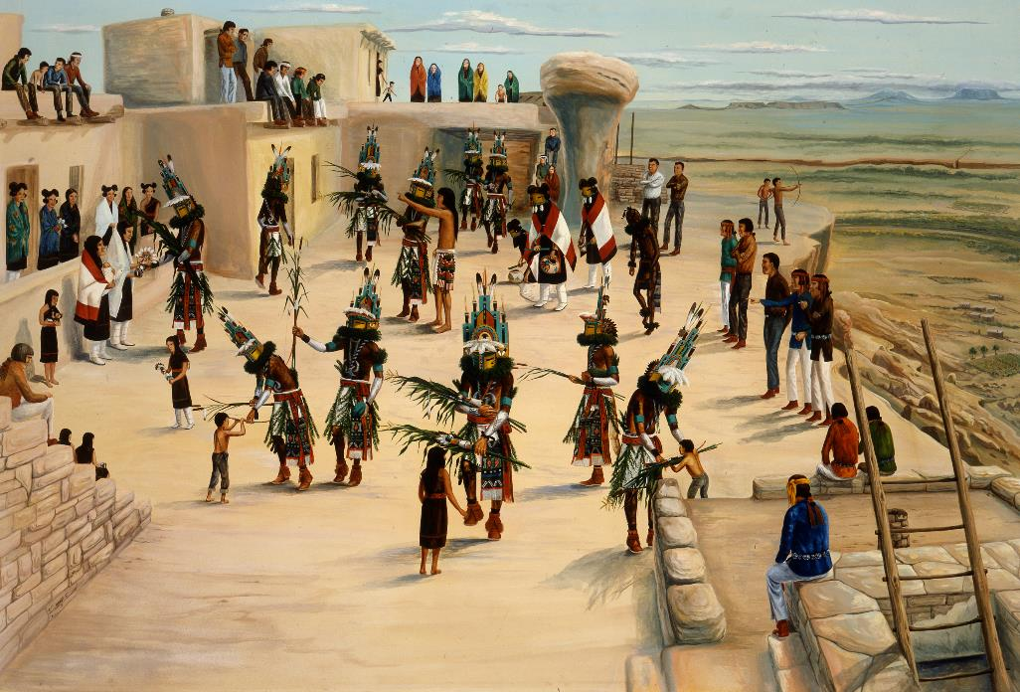
Ray Naha, Hopi
Niman Ceremony at Walpi Village, c. 1965
The figure in the kilt with his long hair takes care of the Katsinam. “He is shoeless because he is praying for rain. If he sees clouds coming, he will put his shoes on. Otherwise, he will stay barefoot.”
Clifford Lomahaftewa

Slide 23
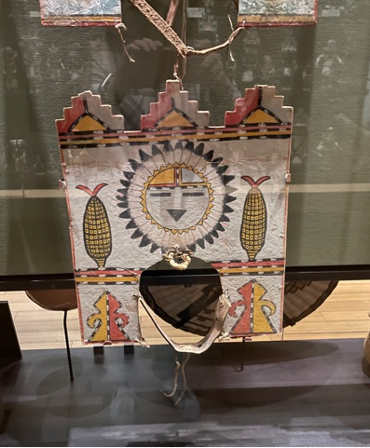
Hopi, Kopatsoki, 1900-1950
The headpieces in the case are from the Butterfly Dance. They are worn by girls in the social dance that is done at the end of summer after the corn has ripened. The entire piece is in the shape of a cloud and three clouds are placed on top with rain symbols below. The sun face flanked by corn completes the theme.

Slide 24
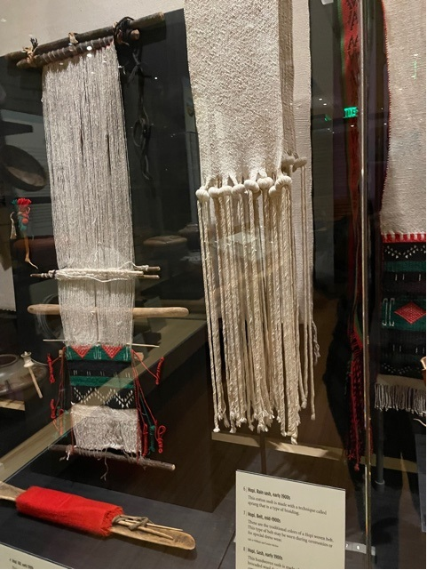
Hopi Rain Sash, early 1900s
The movement of the sash fringe represents falling rain.

Slide 25
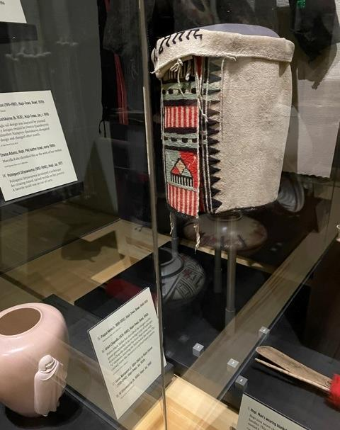
Hopi Kilt, c. 1900
The red and white stripes beneath the rain cloud are supposed to represent sun shining through the falling rain.

Slide 26
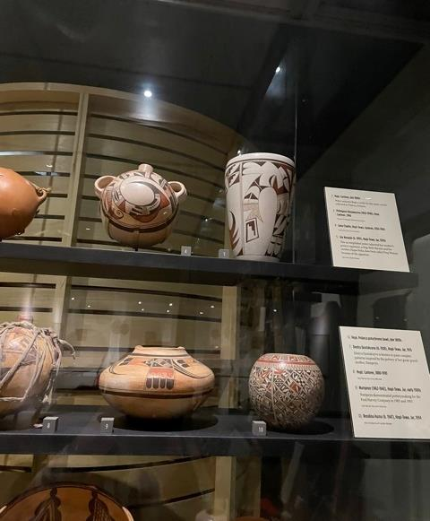
Joy Navasie, Tewa/Hopi Vase, 1970s
The vase on the right is by the accomplished potter known as Frog Woman. She signed her pieces with a frog. It is a symbol she inherited from her mother and is not a clan linkage.

Slide 27
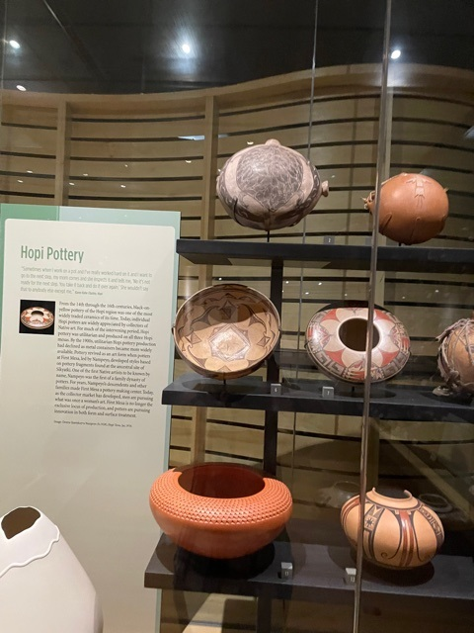
Hopi Canteen, late 1800s
Water serpents flank a turtle on the water carrier that was collected at the Hopi village of Polacca.

Slide 28
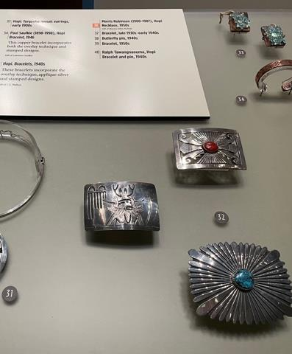
Victor Coochwytewa, Hopi Buckle, c. 1970
The buckle is part of a set. The bolo tie that is in the set has rain clouds at the tips of the tie.

Slide 29
Diné, Joe Ben Jr., advisor

Slide 30
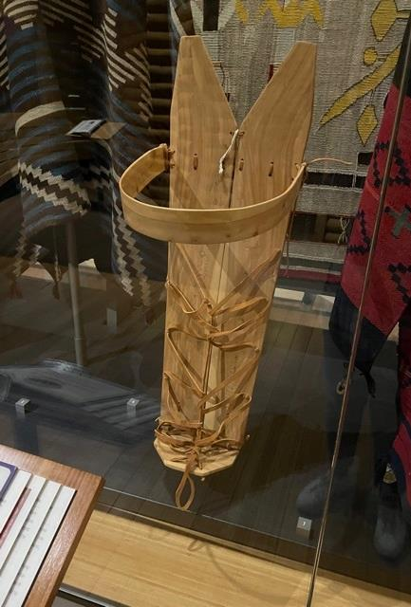
Lolita Curley, Diné Cradleboard, 1996
According to Arlene Old Elk, the cradleboard surrounds a Diné baby with signs of rain. The head piece that protects the baby’s head represents a rainbow and the laces that zigzag across the front represent lightning.

Slide 31
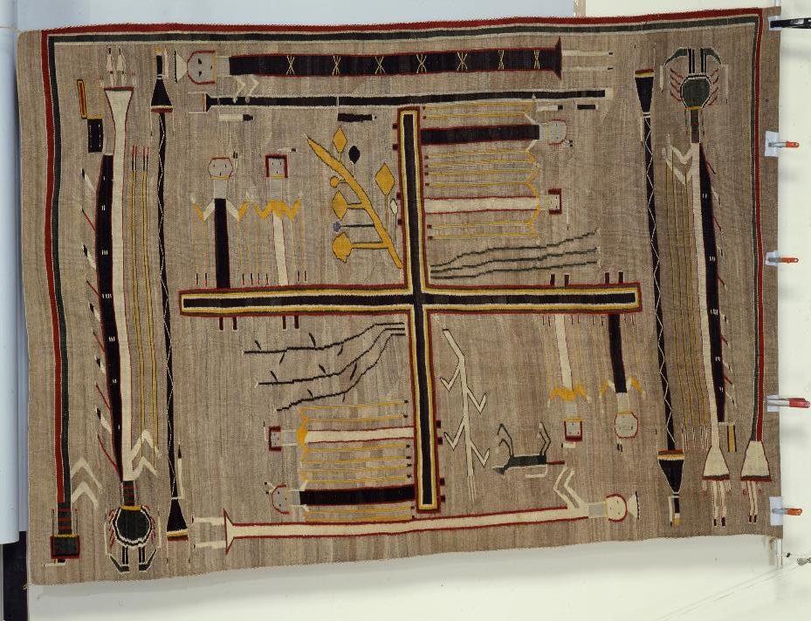
Hosteen Klah, Diné Sandpainting textile, 1921
Considered to be the first textile woven by Hosteen Klah: Whirling Logs sandpainting of the Nightway Ceremony. In includes the Rainbow Guardian and the Mountain Sheep gods who carry on their backs sacks containing black clouds and the fruits of the harvest. Sometimes the center includes the “Water Meeting Place,” a lake on whose shores grow the four sacred plants.

Slide 32
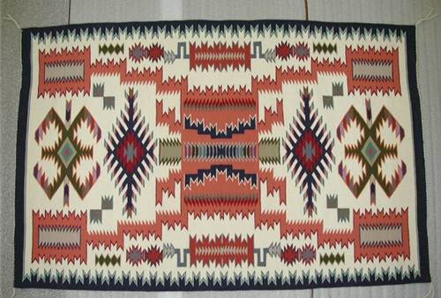
Lillie Touchin, Diné Storm Pattern Textile, 1986
Lightning connects the four sacred mountains at each corner of the textile. The motifs at top and bottom are often called water bugs in the textile literature.

Slide 33
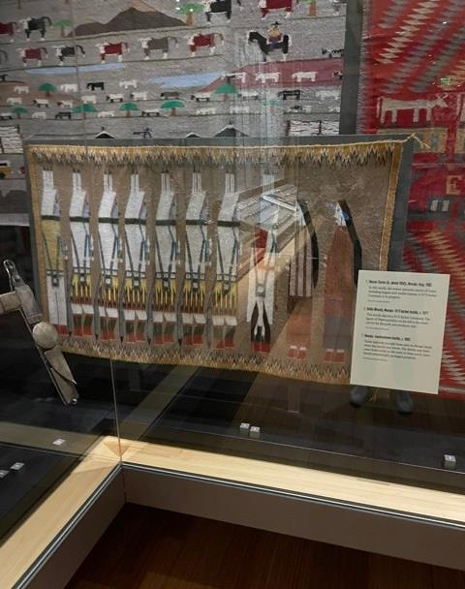
Della Woody, Diné, Ye’ii Bicheii textile, c. 1977
In this textile Joe Ben focused on the figure at the far left, Water Sprinkler.
Water Sprinkler is the water carrier for the Gods and produces rain. His turkey feathers should be white tipped, symbolizing the turkey as the last one to leave the rising waters of the 4th world in the Creation Story.

Slide 34
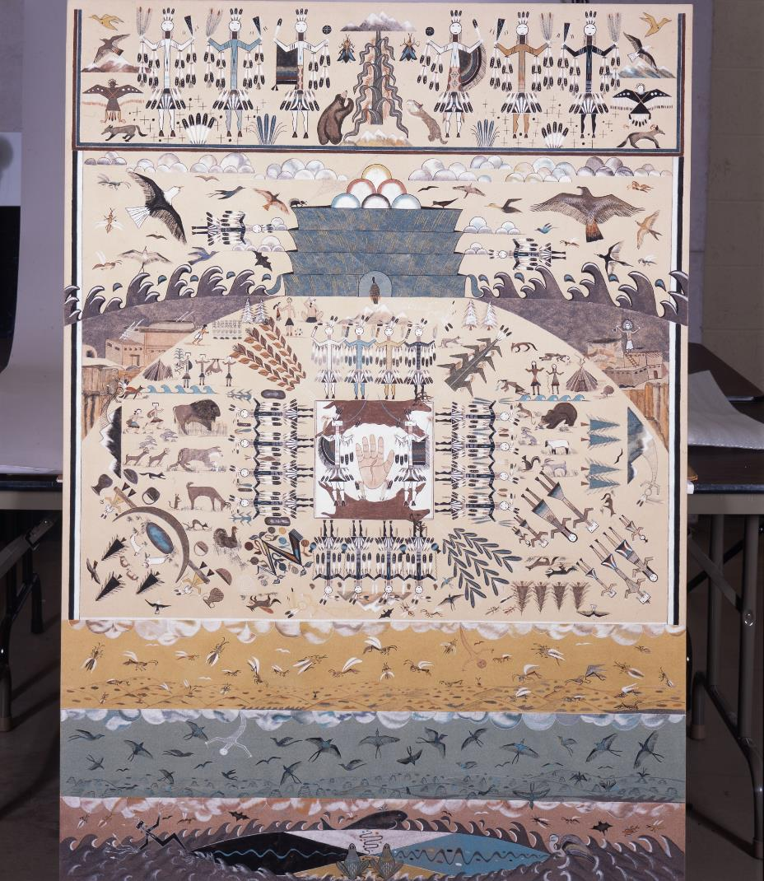
Rosie Yellowhair, Diné Emergence Story, 2004
Yellowhair put the tiny figure of turkey into the center about to emerge from the 4th world. She made his feathers tipped with white.

Slide 35
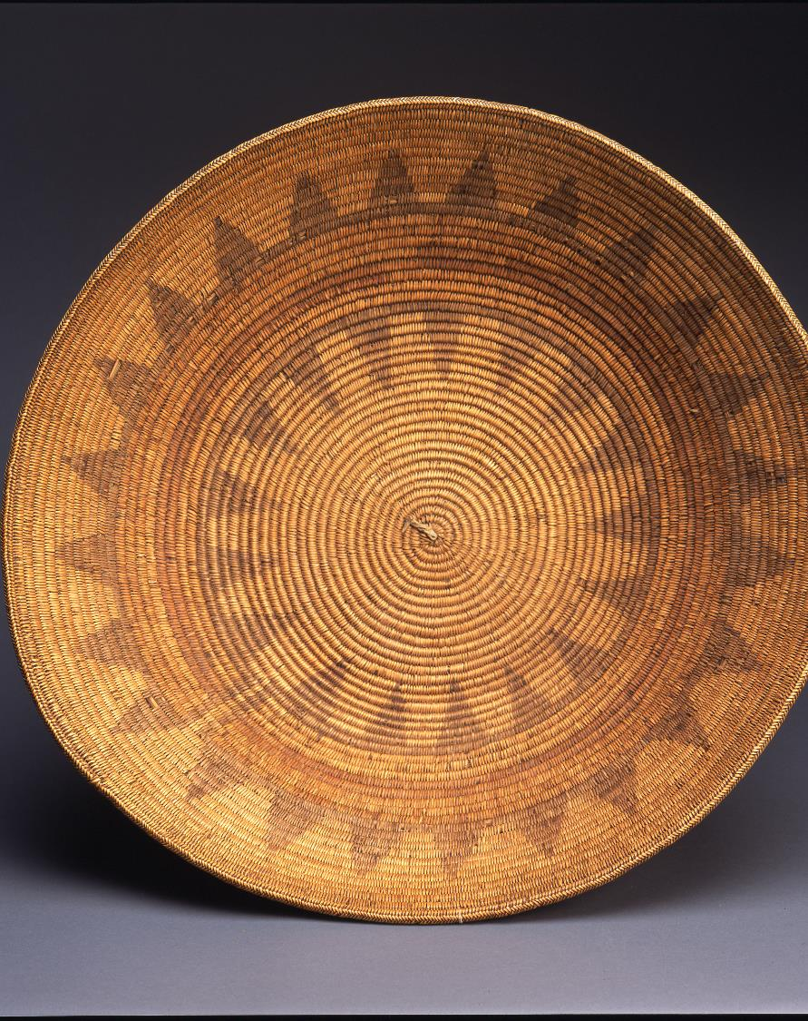
Southern Paiute Diné Ceremonial Basket c. 1900
Paiute weavers have for decades made “wedding baskets” for the Diné. They are actually baskets used in a variety of ceremonies. Joe Ben interpreted the light outer area as daylight, followed by dark, the outer ring as the earth, followed by the rainbow, followed by clouds and mountains. There are a variety of versions of this topic.

Slide 36
Colorado River Tribes

Slide 37
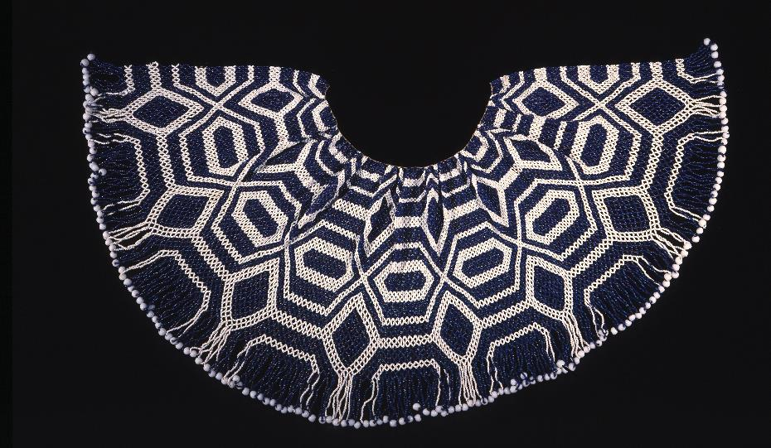
Mohave Cape Necklace, late 1800s
Elder Louise Patch identified this design as turtle shell design with diamond shapes representing the bank of the Colorado River and the elements at the neck representing the river’s tributaries.

Slide 38
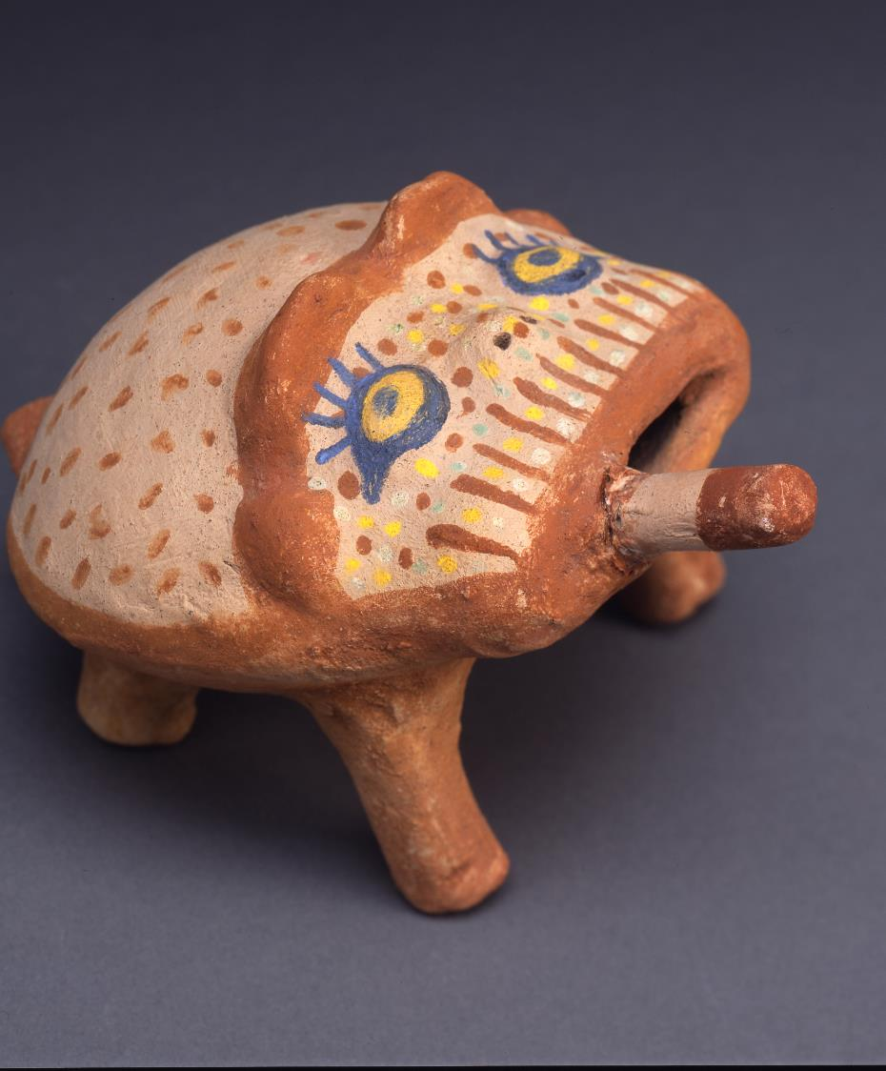
Annie Fields, Mohave, Frog, 1964
Another representation of a water animal. This frog represents the figure that brought fire to the Mohave by carrying a burning stick it its mouth.

Slide 39
Indé, Edgar Perry, advisor

Slide 40
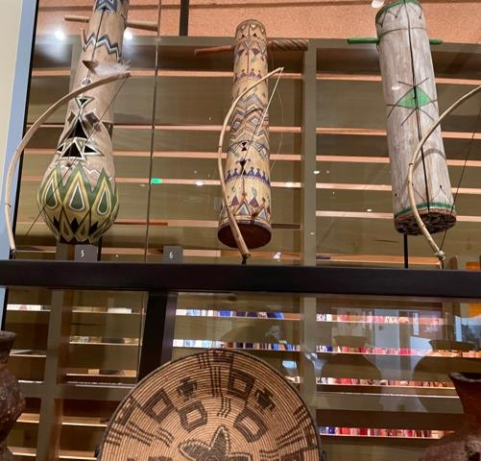
Amos Gastina, Apache, Violin, early 1900s
The triangular symbol with a dot on top was identified by White Mountain Apache advisor Edgar Perry as “rain on the mountain.”

Slide 41
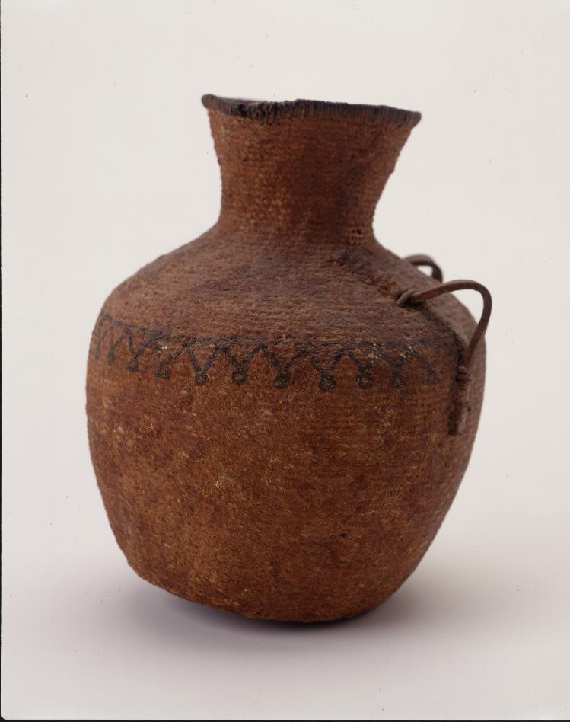
Western Apache, Tus c. 1850
This tus or pitched water bottle has the “rain on the mountains” design. It was given to the museum by the descendants of Chief Loco a leader of the Warm Springs band of Apache during the Apache wars.

Slide 42
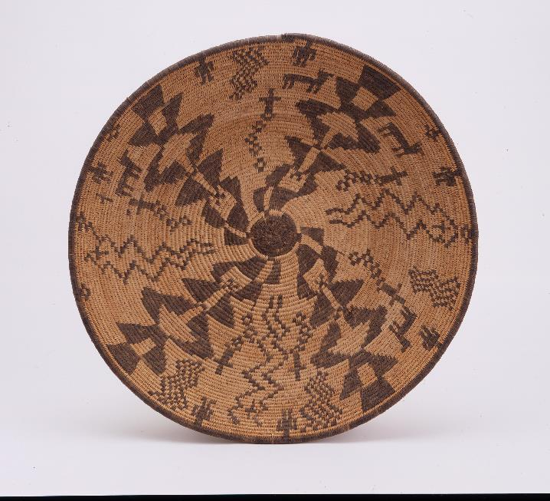
Western Apache, Pictorial basket, early 1900s
The zigzag designs on the basket represent lightning. When asked what symbol he would associate with rain in Western Apache arts, Ronnie Lupe, the chairman of the White Mountain Apache said “lightning.”

Slide 43
Sonoran Desert, Michael Chiago, O’odham advisor

Slide 44
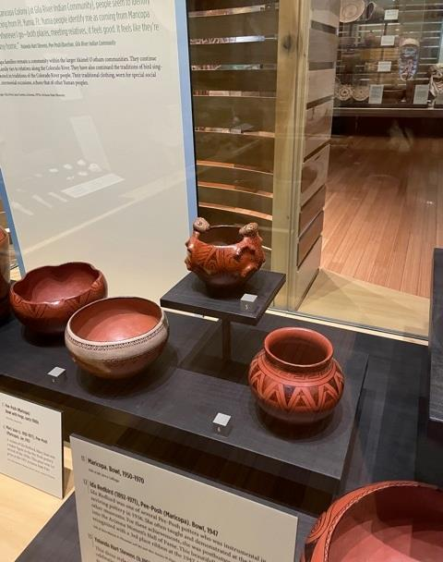
Pee Posh, Frog effigy bowl, early 1900s

Slide 45
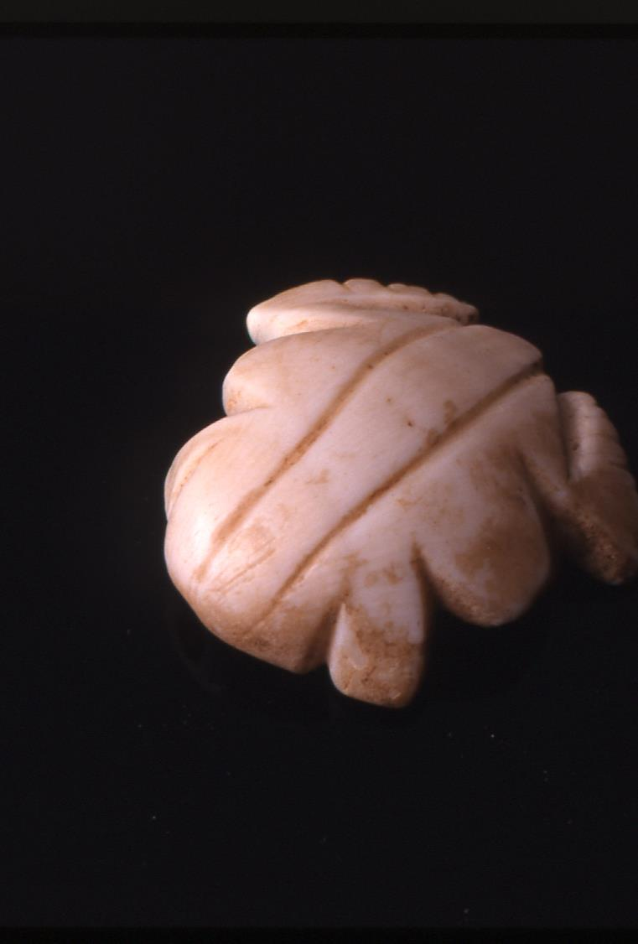
Huhugam Shell Pendant, 650-1100 CE
Many of the pieces in the Huhugam jewelry case have representations of frogs on them. Marine shells were traded into the area. An entire site devoted to shell working has been found.

Slide 46
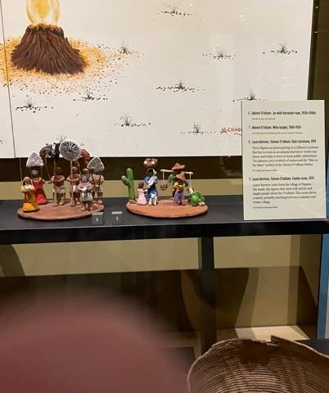
Laura Kerman, Tohono O’odham, Célkona Ceremony, 1979
This set of clay figures depicts the fall harvest/winter rain ceremony. Some figures carry representations of clouds.

Slide 47
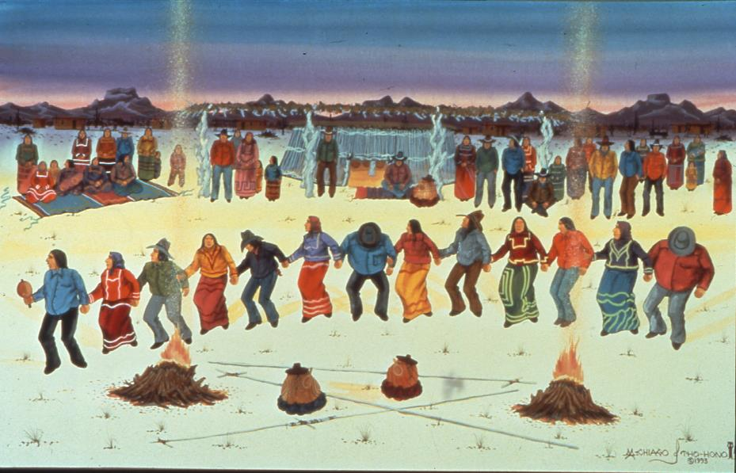
Michael Chiago, Tohono O’odham, Rain House and Saguaro Wine Festival, 2003
This ceremony has also been referred to as “pulling down the clouds.” It features songs, oratory, poetry and the drinking of saguaro wine. The wine ferments for three days in the rain house shown at the rear of the group. Traditionally crops were planted after the ceremony.

Slide 48
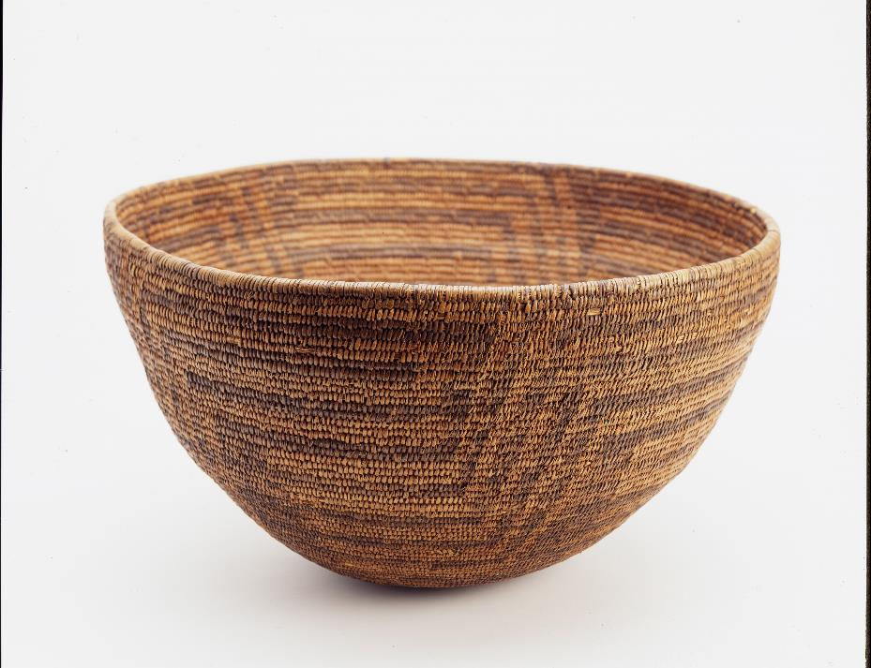
Tohono O’odham saguaro wine basket, early 1900s
Wine baskets are woven so tightly that they can hold liquid. It is from these baskets that the wine is drunk in the summer wine ceremony.

Slide 49
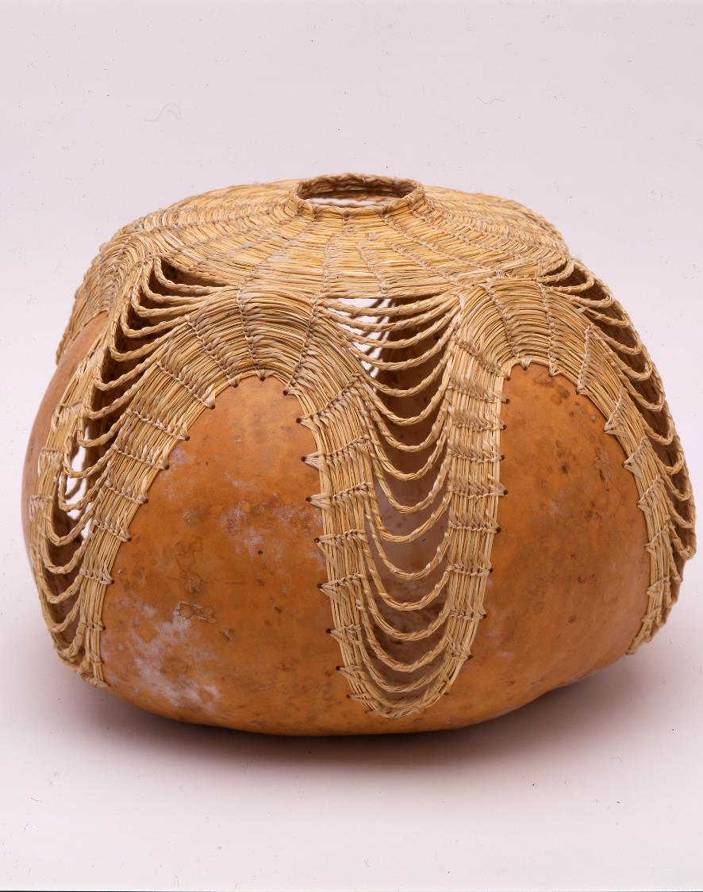
Terrol Dew Johnson, Tohono O’odham, Contemporary gourd basket, 2001
The artist has said that the design of the bear grass in the basket represents ripples in a pond caused when a stone is tossed in.

