Slide 1
DEFENDING HOME

Slide 2
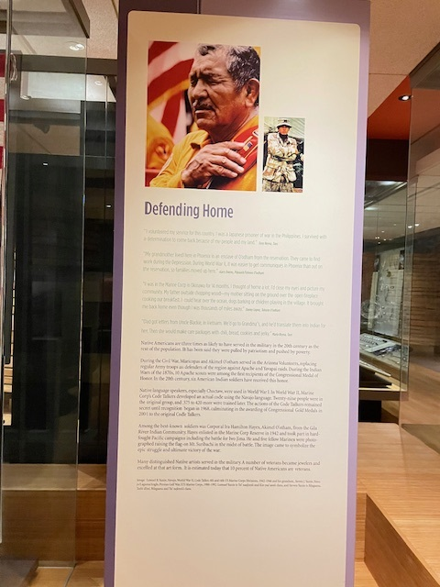
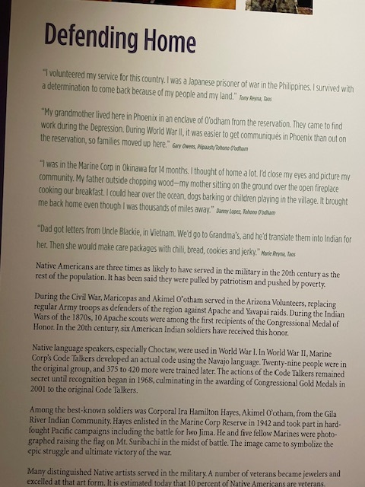
Photos feature Lemuel
Yazzie, a WW II Code
Talker and Lemuel’s
grandson, also a Marine
Steven Yazzie who was in
the Persian Gulf War

Slide 3
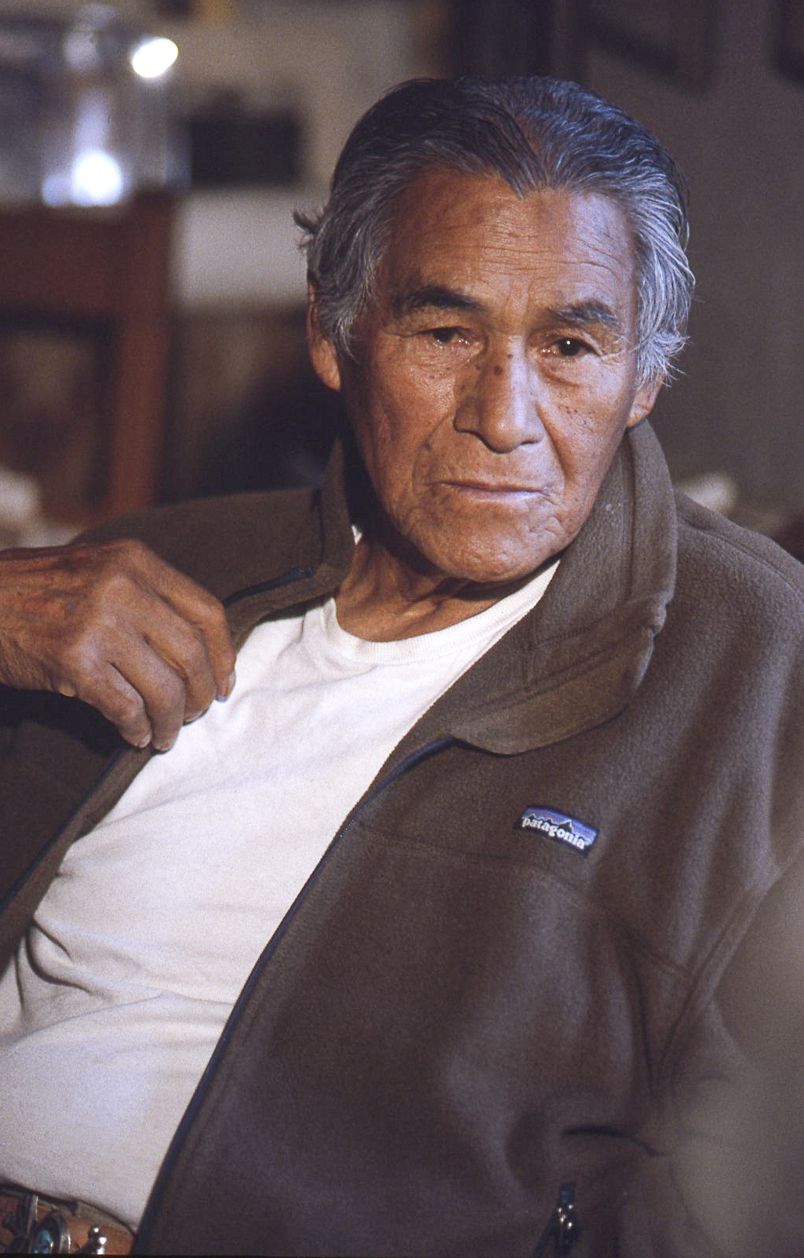
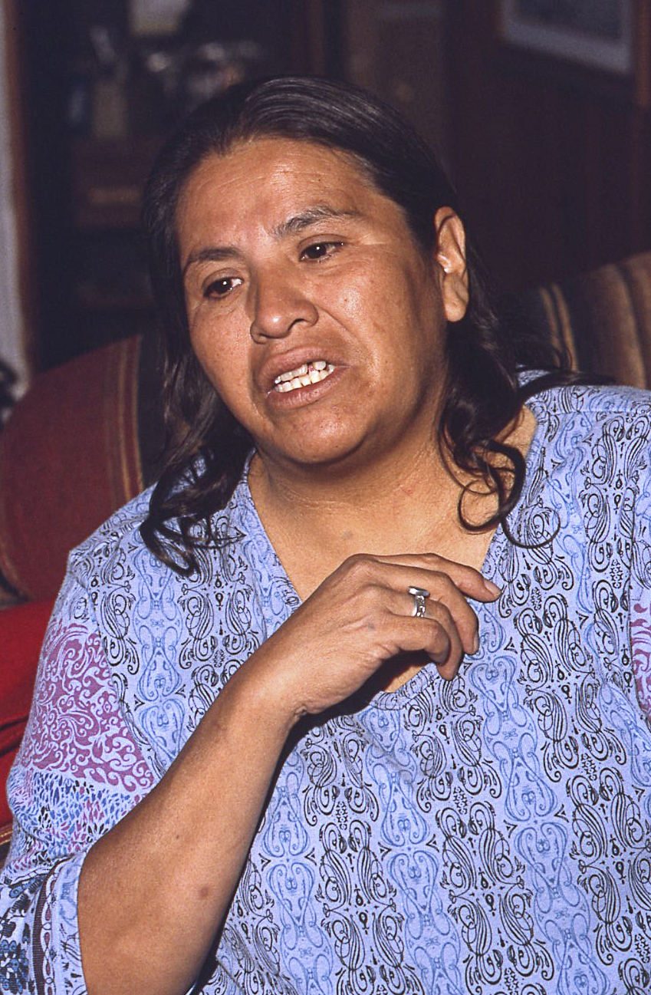
DEFENDING HOME
I volunteered my service for this country. I was a Japanese prisoner of war in the Philippines. I survived with a
determination to come back because of my people and my land. Tony Reyna, Taos Pueblo
My grandmother lived here in Phoenix in an enclave of O’odham from the reservation. They came to find work during
the Depression. During World War II, it was easier to get communiqués in Phoenix than out on the reservation, so
families moved up here. Gary Owens, Pee Posh, Tohono O’odham Red Bottom Assiniboin
I was in the Marine Corp in Okinawa for 14 months. I thought of home a lot. I’d close my eyes and picture my
community. My father outside chopping wood—my mother sitting on the ground over the open fireplace cooking our
breakfast. I could hear over the ocean, dogs barking or children playing in the village. It brought me back home even
though I was thousands of miles away. Danny Lopez, Tohono O’odham
Dad got letters from Uncle Blackie in Viet Nam. We’d go to grandma’s, and he’d translate them into Indian for her.
Then she would make care packages with chili, bread, cookies and jerky. Marie Reyna, Taos Pueblo

Slide 4
This section has some of the most important comments in the exhibition, in part, because the comments fully ground
American Indian people in events of the 20th century.
It also is among the most relatable to anyone who has ever served abroad or who has had a family
member serving abroad.
It underscores the difficulties that arise for people living in a 20th century rural environment without convenient
means of communication, either mail or telephone.

Slide 5
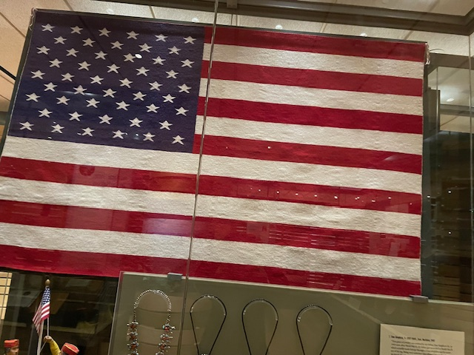
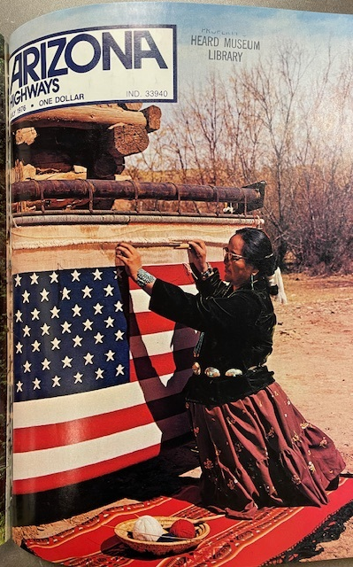
Sadie Curtis weaving the textile in HOME.
The textile was commissioned by Arizona
Highways Magazine for the Bicentennial and
shown on the magazine’s July 1976 cover in a
photo taken by Jerry Jacka.
This textile had gromets sewn on to it to enable it to be flown over the U. S. Capitol and the Arizona State Capitol. The museum
purchased the textile after the terrorist attack of 9/11. It was first shown in the exhibition More Than Art.

Slide 6
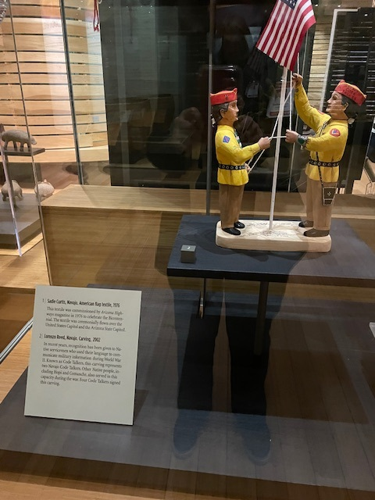
The Navajo Code Talker carving was made by Lorenzo Reed in 2002.
People will have heard of the Marines who were Navajo Code talkers, but
might not know that Native languages, especially Choctaw, were used in
WW I.
Other Native languages, including Hopi, were used in WW II, but it was the
Navajo language that was the basis for code. Ultimately between 375 and
420 Navajo were trained in the code. Their work remained secret until 1968.
The original 29 were recognized with Congressional Gold Medals in 2001.

Slide 7
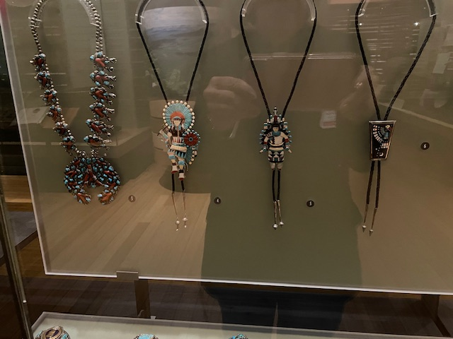
Dan told us his father had
his workbench arranged to
fit the sequence of steps
needed to create the piece.
Dan Simplicio, Sr. (1917-1969), Zuni. Necklace, 1945. “This piece of jewelry was created by my father, Dan Simplicio, Sr.,
in 1945 soon after World War II. My father got wounded in World War II, which actually made him go through a long
rehabilitation for recovery of his leg. Consequently, it restricted a lot of mobility for him. Being very sedentary also allowed him
to sit and work on details for a long time. In this piece, there are a number of tiny little elements that required an extensive
amount of time. These are all handmade drops that he did. He would actually get small pieces of silver, melt that down and shape
it into a round ball. And while it’s still hot, he would take a poker or prod and touch it to imprint the design on it while it’s still
flexible in a melted state. After it cooled off, he would solder it to the design.” Dan Simplicio, Jr.,

Slide 8
Edward Beyuka, Zuni. Bolo tie, c. 1969. The
artist is known for his figurative work, such as this multipart bolo tie of a Plains dancer. The shield removes to become a pin, and the feather in the dancer’s left hand detaches to become a tie tac. Edward Beyuka survived the Bataan Death March of World War II and took up jewelry making in 1956.
This tie has five separate
pieces.

Slide 9
Jesse Monongya (b. 1952) Navajo. Bolo tie, c. 1984.
Jesse Monongya began making jewelry following service with the Marines in Viet Nam.
The tie is part of a set that won Best of Show at O’odham Tash in 1984 or 1985.
“It shows a sun face, the new direction quarter moon, the shooting star and the evening star.”

Slide 10
Navajo. Bracelet, 1940s. This bracelet belonged to
someone who received a Purple Heart medal in
World War II. It is set in a bezel of heavy twisted wire
and flanked by turquoise stones.
Lloyd Oliver, Navajo. Bracelet, early 1960s. Lloyd Oliver was a Code Talker during
World War II, and he was recognized for his participation in that capacity at veterans’ events.
This bracelet was made by him following the war.

Slide 11
Eskiesose, Navajo. Belt buckle, n.d. “I’ve been in the military, and
this is similar to one of the brass buckles that I used to shine all the
time. The owner was probably in the military a long time and fell
in love with the buckle and got home and had a silversmith do this
overlay. And then somebody bought this beautiful spiderweb
turquoise and included it in the buckle.” Jesse Monongya, Navajo.

Slide 12
Paul Saufkie (1898-1993), Hopi. Belt buckle, early 1960s. Paul Saufkie was
the principal technical instructor for the Hopi G.I.s’ silversmithing program. Saufkie
began making jewelry in the 1920s.
Jesse Monongya (b. 1952), Navajo. Bracelet, c.1977.
“This is one of my favorite pieces is because it shows the mudhead’s muscle structure along the curve of
the muscle structure. It took a lot of stone just to get that curve. It's a mudhead dancing, and also it has the
Hopi sun face.” Jesse Monongya

Slide 13
Be sure to mention the American Indian Veterans National Memorial on our grounds.
You might also encourage people to visit Away From Home and mention the American Indian boarding schools
founded in the late 1800s in the War Department and the military-style training model that shaped the students’
experiences for decades.

